Slide 1
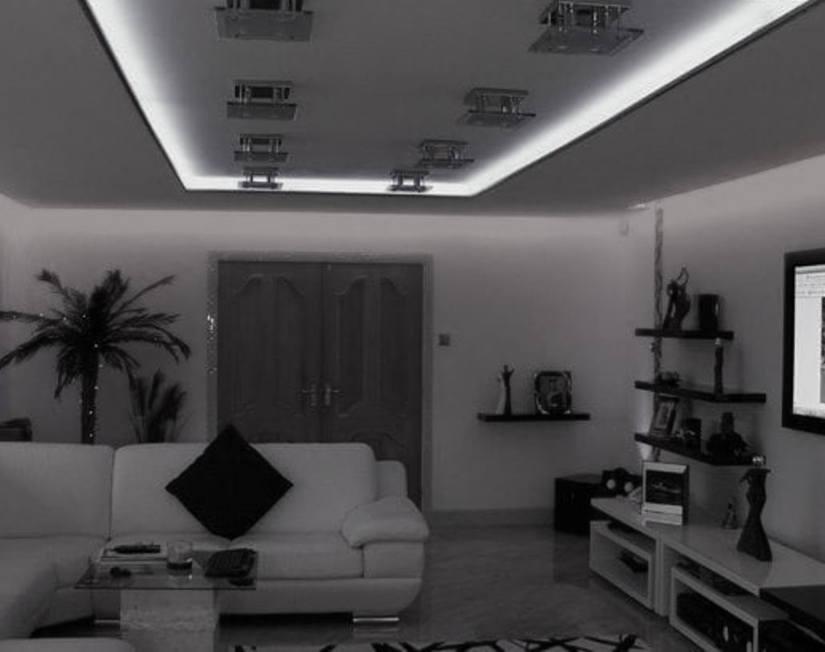
It doesn’t have to be like this…

Slide 2
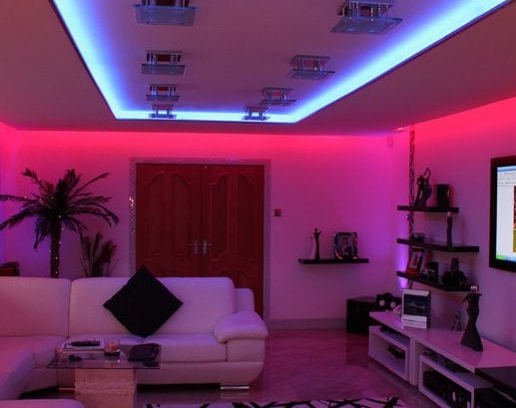
…when it could be like this.
Create and configure your own playlist for each day
Set an ambient light preference for each playlist
Multiple user support
Get it with just one touch

Slide 3
ONE TOUCH COZY MOOD
We are using:
-Raspberry Pi
-Web Application with user-friendly GUI
-Fingerprint sensor
-Bluetooth speaker
-LED RGB lights

